Slide 1



Comparative Study of Generative Models for Early Detection of Failures in Medical Devices
First International Medical Device Safety Risk Management Conference
April 2024
Binesh Kumar*, Sr. Principal R&D Engineer, Medtronic
Bahareh Arghavani Nobar, Graduate Research Assistant, SAIL Lab
Dr. Vahid Behzadan, Director, SAIL Lab, University of New Haven

Slide 2
Agenda
Introduction
Research Problem
Research Methodology
Review of the state of the art
Study Setup
Study Results
Conclusion & Next Steps
First International Medical Device Safety Risk Management Conference | Generative Models for Fault Detection | April 2024

Slide 3
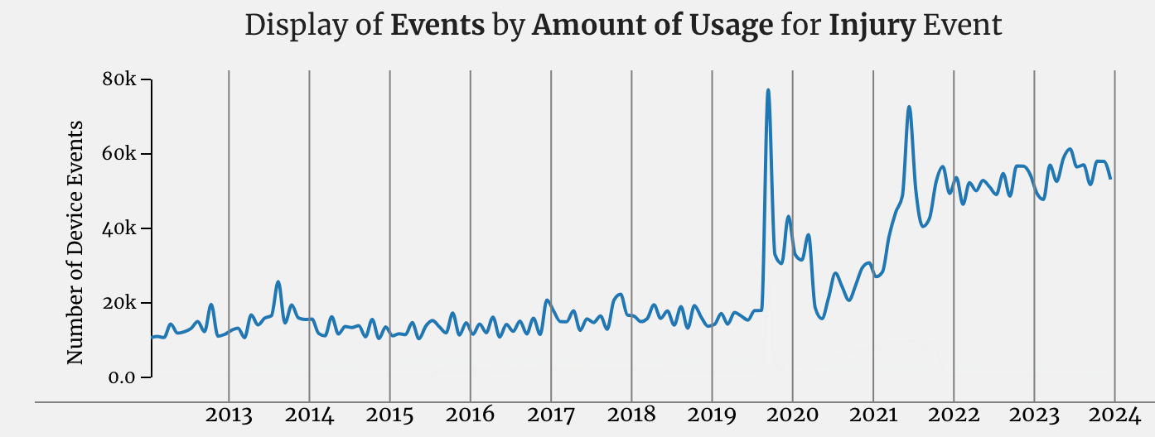
Introduction
The Problem
Fig:1 Device Failures Resulting in an Injury
Source: FDA Open Access - MAUDE
2006-2011: 5,294 device recalls, 1.15M adverse events, 92,600 injuries, 25,800 deaths [Ale+13]
2017: 627 software devices recalled, 12 high-risk [RZ17]
2018-2020: 383 stapler complications, 22 deaths [CB22]
First International Medical Device Safety Risk Management Conference | Generative Models for Fault Detection | April 2024
Notes:
→ too much

Slide 4
Introduction
The Problem
Fault diagnosis is a seasoned field of research, and many critical medical devices maintain an embedded expert system to self diagnose
Increasing complexity of the devices and the variability in the operating environment results in failures which are often hard to predict and prevent by expert systems
Majority of medical devices embed intricate electro-mechanical components with varying properties where failure is not linear
The increasing complexity of medical devices, particularly in their electronics and software components, presents significant challenges in terms of safety, reliability, and efficacy [JSR13]self-diagnose
Definitions
Fault: An unpermitted deviation of at least one characteristic property or parameter from the expected normal condition in a piece of equipment or a system that may lead to a failure
Fault detection: Fault detection is monitoring approaches to detect, isolate, and identify the faults by using the concept of redundancy, either hardware redundancy or analytical redundancy
Failure Prediction: Prediction of the future status of the faulty component(s) and estimation of the remaining useful lifetime based on the available information. The prognosis task allows predicting the future state of damage, rather than diagnosing the current state of damage
Anomaly detection: refers to the problem of finding patterns in data that do not conform to expected behavior
First International Medical Device Safety Risk Management Conference | Generative Models for Fault Detection | April 2024

Slide 5
Introduction
Study Framework
Research Problem
Literature Review
Framework Development
Preliminary Study
Given the increasing complexity of medical devices and the rising incidence of device-related failures and recalls, there is a pressing need to develop and implement advanced generative methods for more effective and reliable fault detection in these devices.
Conduct a literature review on medical device failures and fault detection techniques, focusing on the role of generative models in prediction and prevention.
Establish the theoretical foundation, research objectives and hypotheses.
Analyze two generative algorithms (GAN, VAE) and one classic (HMM) for their effectiveness in fault detection.
Evaluated the applicability against
Real world Surgical device sensor data
Airbus anomaly detection as benchmark dataset
First International Medical Device Safety Risk Management Conference | Generative Models for Fault Detection | April 2024

Slide 6


Introduction
Team
Quality is a cornerstone of the Surgical Stapling mission, and we believe that with predictive and preventive maintenance we would further enhance our customer experience
Stapling Research & Technology team partnered with University of New Haven’s Secured and Assured Intelligence Lab (SAIL) for an independent study to survey the state-of-the-art Fault Detection and Prediction algorithms and perform a feasibility study to understand the applicability to medical devices.
Binesh Kumar
Sr Prin. Engineer, ASI
Principal Investigator
Dr. Vahid Behzadan
Principal Investigator
Vahid Behzadan is an Assistant Professor in Computer Science and Data Science. He is also the founder and director of the Secure and Assured Intelligent Learning (SAIL) research group, and mentors the University's hacking team. Dr. Behzadan's research is primarily on the safety and security of artificial intelligence and complex adaptive systems. His pioneering work on the security of deep reinforcement learning is recognized as seminal contributions to this growing field of research
Andrew Miesse
Director, R&T Surgical
Advisor & Sponsor
Bahareh Arghavani Nobar
Research Assistant
She is currently a Master's in Data Science student at the University of New Haven and works as a research assistant at SAIL Lab, where her primary focus is on AI applications in healthcare.
First International Medical Device Safety Risk Management Conference | Generative Models for Fault Detection | April 2024

Slide 7
Introduction
Literature Review
Literature Survey
Semi-systematic literature survey for each of the below topics, qualitative/quantitative analysis, the development over time, and synthesizing and comparing evidence using data generated by a medical device
Survey of fault detection approaches in medical devices, established benchmarks, datasets, and tools
Survey of supervised and unsupervised machine learning techniques
Survey of deep generative and Reinforcement Learning(RL) based approaches to fault detection and evaluation of an online RL + Generative Adversarial Networks approach to fault prediction
Survey of Koopman operators for fault detection as well as a novel formulation of Koopman approach to fault prediction in medical devices
Databases
IEEE, Scopus databases and proceedings from International Symposium on Reliable Distributed Systems, International Conference on Software Engineering, International Conference on Machine Learning and Application, Conference on Neural Information Processing Systems and Association for the Advancement of Artificial Intelligence conferences
First International Medical Device Safety Risk Management Conference | Generative Models for Fault Detection | April 2024

Slide 8
Literature Review
Fault Diagnosis & Prognosis
An effective Fault Diagnosis & Prognosis system requires fast and reliable fault detection, isolation and prognosis
Fault prognosis is challenging due to uncertainties in the system, prediction horizon of the failure and lack of measurements directly related to the dynamics of failures
Failure Mode Identification
Failure Prediction
Failure Model can either be constructed based on a deep understanding of physics of failure
Alternative approach is by black-box models, primarily data-driven
Neural networks or Adaptive Neuro-fuzzy Inference systems are commonly used black-box models
Accuracy of failure model have cascading effect on failure prediction
Objective is to forecast the RUL of a faulty system using the measured failure data and model
Two approaches are deterministic & probabilistic
Deterministic models predict exact failure time
Probabilistic models determines a sequence representing system state
First International Medical Device Safety Risk Management Conference | Generative Models for Fault Detection | April 2024
Notes:
remaining usedfyl life

Slide 9



Literature Review
Fault Mode Identification - Knowledge Based Systems
Medical devices widely use Knowledge-Based systems for fault detection and as decision support tools [MartinT91]
These systems include a knowledge database and an inference engine to predict anomalies, indicating potential faults.
Their popularity stems from reliability and simplicity, but creating a complete rule set for complex systems can be challenging.
Traditional model-based techniques are also common for product reliability testing during the development phase [MartinT91]
First International Medical Device Safety Risk Management Conference | Generative Models for Fault Detection | April 2024
Notes:
-- redesign the slide, bigger diagrams and summarize text to bullet points

Slide 10
Literature Review
Fault Mode Identification - Observer Methods
Sensor-reliant critical devices often use observer-based methods, calculating residuals from system outputs and observer estimates.
Common approaches include dedicated observer schemes and robust sliding mode observers, both closed loop and multiple open-loop types.
There's a balance between estimation accuracy and fault detection capability in these methods.
Physical system x
Physical system x
u
y
u
y
Closed Loop Observer
Open-Loop Observer
x̄
x̄
First International Medical Device Safety Risk Management Conference | Generative Models for Fault Detection | April 2024
Notes:
-- redesign the slide, bigger diagrams and summarize text to bullet points

Slide 11
Literature Review
Supervised Fault Detection
Fault detection using supervised learning technique involves feature extraction, selection and fault classification
Feature extraction improves the information density – kernel based PCA is very commonly used in fault detection, FFT (Fast Fourier Transform) is often used for time series [DSJN19]
Feature selection methods aims to improve the quality of data, supervised methods such as Correlation Based Feature Selection and Fast Correlation Filter are widely used [YuL03].
Popular feature selection methods for time series are mean, variance, kurtosis and for sequences distance-based entropy is employed [TsimpirisA12]
Data Pre-processing
Feature Extraction and Selection
Classification model training
First International Medical Device Safety Risk Management Conference | Generative Models for Fault Detection | April 2024

Slide 12
Literature Review
Supervised Fault Detection
Popular supervised learning techniques for fault detection are linear and logistic regression models, support vector machines, decision tree, clustering techniques and Naïve Bayes [HaTMP19]
SVM is a popular choice among researchers for time series classification [HaTMP19]
Multi-class approach using SVM is computationally expensive and is often challenging for online classification based on a study by Cheng Jing et. Al
In real-world there is scarce of of labeled anomalous training samples often leads to class imbalance
First International Medical Device Safety Risk Management Conference | Generative Models for Fault Detection | April 2024

Slide 13
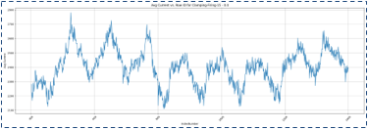
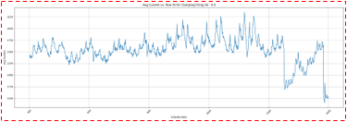
Research Methodology
Stapler Dataset
The Surgical Stapler Dataset includes time series signals from a motorized laparoscopic stapler, with 3000 samples per instance.
Captures three distinct features at a 1 kHz sampling rate in benchtop settings.
Uses high-speed camera data to accurately mark anomalies and faults for precise fault detection analysis.
Fig:2 Staple Motor Current Data - Normal
Fig:3 Staple Motor Current Data - Faulty
First International Medical Device Safety Risk Management Conference | Generative Models for Fault Detection | April 2024
Notes:
→ benchmark based on baseline airbus and then stapler ds

Slide 14
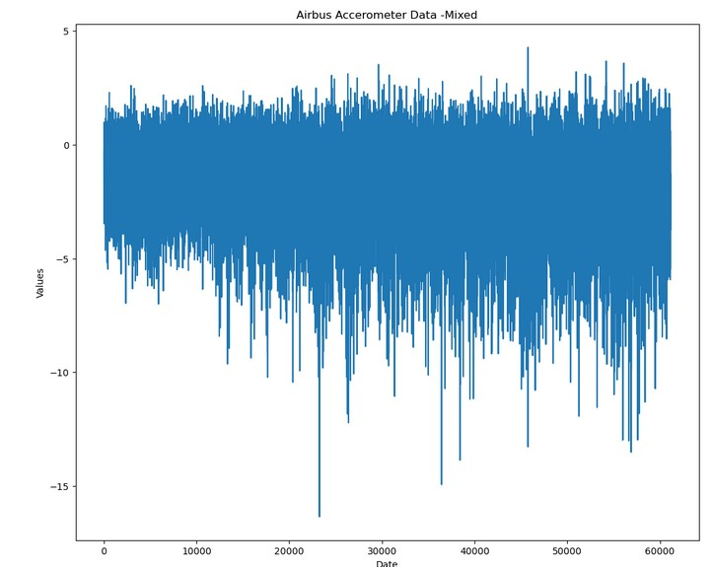
Research Methodology
Airbus Dataset
The dataset serves as a baseline for fault detection, capturing vibrations from real helicopter flight tests using accelerometers placed at various positions.
Includes 1,677 sequences of normal flights for training, which are essential for understanding standard vibration patterns.
For testing anomaly detection, it provides a balanced test set with 594 sequences, encompassing both normal and abnormal flight conditions.
Fig:4 Airbus Helicopter Vibration Data - Mix
First International Medical Device Safety Risk Management Conference | Generative Models for Fault Detection | April 2024
Notes:
→ benchmark based on baseline airbus and then stapler ds

Slide 15
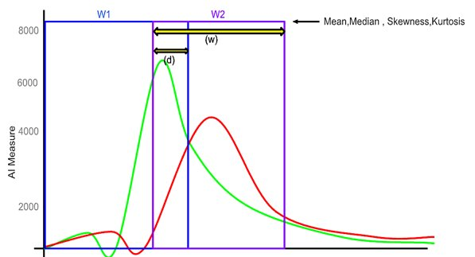
Research Methodology
Data Pre-Processing
Sequence Padding: Standardized sequence lengths with padding, creating a uniform input for model training.
Windowing: Segmented continuous data into fixed-size windows for localized analysis.
Feature Extraction: Computed statistical features (mean, median, skewness, kurtosis) within each window to capture data characteristics.
Data Splitting: Divided data into training (80% normal samples) and testing sets (remaining normal and all faulty samples).
Data Scaling: Implemented standardization using MinMax for stable and efficient model training.
Fig:6 Windowing Approach In Pre-Processing
First International Medical Device Safety Risk Management Conference | Generative Models for Fault Detection | April 2024

Slide 16
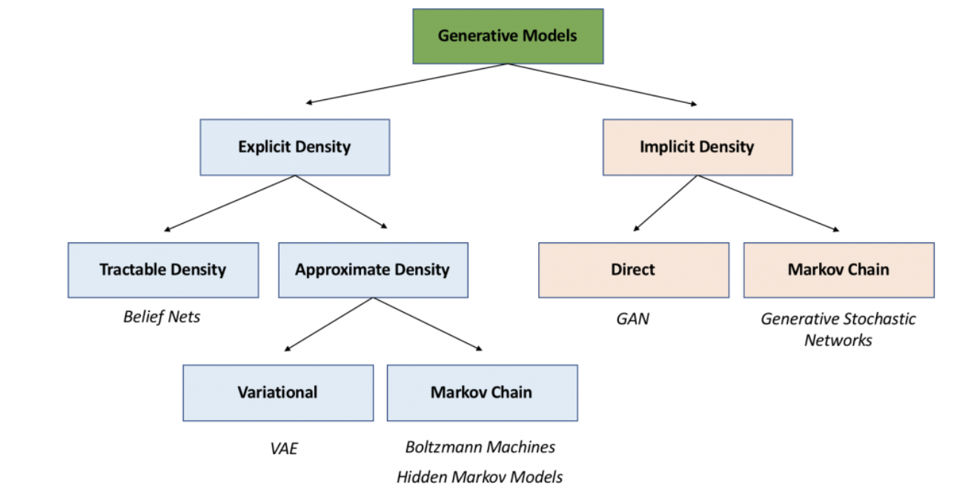
Deep Generative Model Approaches
First International Medical Device Safety Risk Management Conference | Generative Models for Fault Detection | April 2024

Slide 17
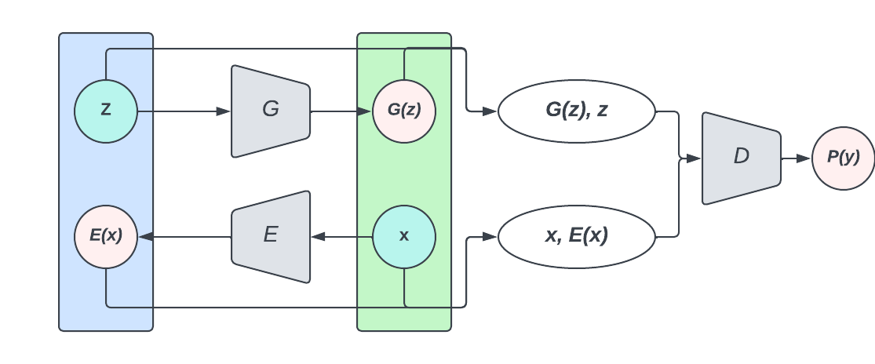
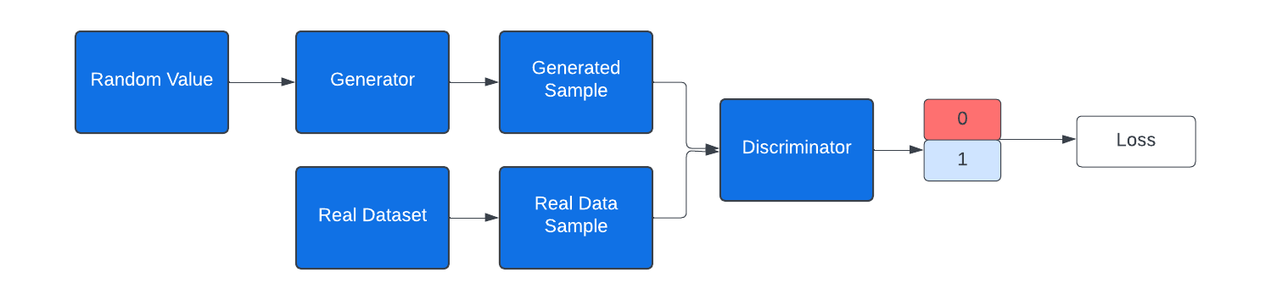
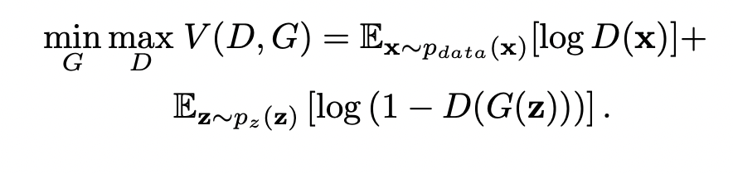
Deep Generative Model Approaches
Unsupervised Learning
Fig:7.a GAN Architecture
Fig:7.b GAN Architecture
GANs operate on an adversarial process involving two models: a discriminator (D) and a generator (G), trained simultaneously in a zero-sum game.
The generator's goal is to capture the data distribution, while the discriminator evaluates whether a sample is from the training data or the generator.
Training GANs only on normal samples enables the generator to learn normal data patterns, leading to increased reconstruction error for anomalous samples
First International Medical Device Safety Risk Management Conference | Generative Models for Fault Detection | April 2024
Notes:
Redraw it--- change color and/or design
Unsupervised approaches requires only non-faulty data, since their operating principle is the detection of occurrences that deviate from normal
One-class support vector machine is a commonly used fault detection method among connected IOT equipment
Our study focused on Deep generative models for unsupervised fault detection

Slide 18
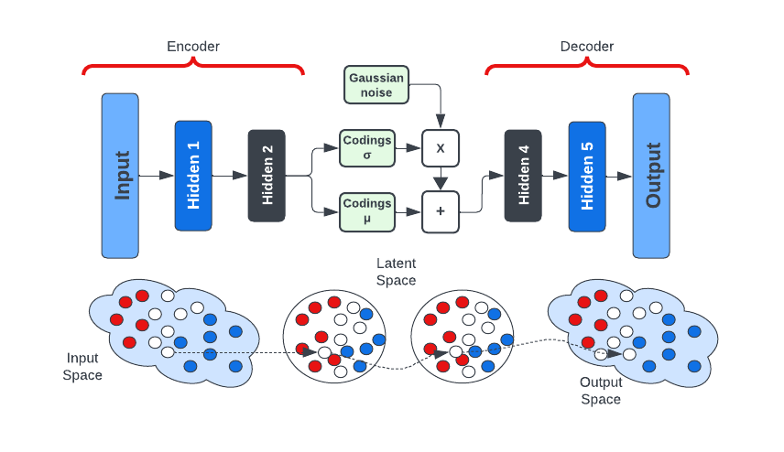
Deep Generative Model Approaches
Unsupervised Learning
Fig:8 VAE Architecture
VAEs are likelihood-based generative models that maximize the training data likelihood using the model pθ(Data).
They use latent variables z to compute pθ(x), integrating over pθ(x|z)p(z)dz.
VAEs are trained efficiently via an inference distribution qφ(z|x).
Anomalies in VAEs are identified by high reconstruction error or low probability, as they represent deviations from the learned distribution.
The best threshold for anomaly detection is set by evaluating different thresholds and choosing the one that maximizes the F1 score which is (6.92), balancing precision and recall.
First International Medical Device Safety Risk Management Conference | Generative Models for Fault Detection | April 2024
Notes:
--- redraw

Slide 19
Classic Generative Model Approaches
Unsupervised Learning
Fig:9 HMM Architecture
HMMs are preferred for statistically modeling linear time series or sequence problems.
They consist of an unobservable stochastic process, inferred through a sequence of observable symbols.
Defined by λ = (A, B, π), where A is the state transition probability matrix, B the observation symbol probability matrix, and π the initial state probability vector.
HMM-based anomaly detection involves training on normal observations, calculating normal behavior states, and comparing these to states from new data for anomaly identification.
The best threshold is found by trying different percentiles of log-likelihood values and evaluating which one gives the highest F1 score which is 21 percentile, ensuring a good balance between detecting anomalies (recall) and avoiding false alarms (precision)
Observations
Y₁
Y₂
Y₃
X₁
X₂
X₂
Hidden State(Unobserved)
P(X_{1:T} , Y_{1:T} ) = P(X₁)P(Y₁|X₁) ∏ ^{T} _{t=2} P(X_{t}|X_{t−1})P(Y_{t}|X_{t})
First International Medical Device Safety Risk Management Conference | Generative Models for Fault Detection | April 2024
Notes:
Avg_Velocity: Average velocity – the speed at which components of the stapler move during operation.
PWM_Output: Pulse Width Modulation Output – controls the power delivered to the motor, affecting how the device functions.
SG_NoFilter: Strain Gauge (No Filter) – raw measurement from the strain gauge, which measures force or tension in the device.
Setpoint: The target or desired value for a specific parameter, such as the force or speed, that the device is trying to achieve.
StrainGage: Strain Gauge – a sensor used to measure the strain or force exerted on a component during stapling.
avg_current: Average Current – the average electrical current drawn by the device’s motor or system during operation.
current_filter: Filtered Current – the current measured after applying a filter to remove noise or fluctuations in the data.
ticks: Encoder Ticks – signals from a rotary encoder, used to track the movement or position of components.
Articulation: Movement or bending of the stapler's end effector (the part that interacts with tissue) during operation.
Tissue: A measurement or indicator of the tissue being stapled, potentially representing its properties.
Tissue_Thickness_inch: Thickness of the tissue being stapled, measured in inches.
Firing_Type: The mode or type of firing mechanism used by the stapler, such as manual or powered firing.

Slide 20
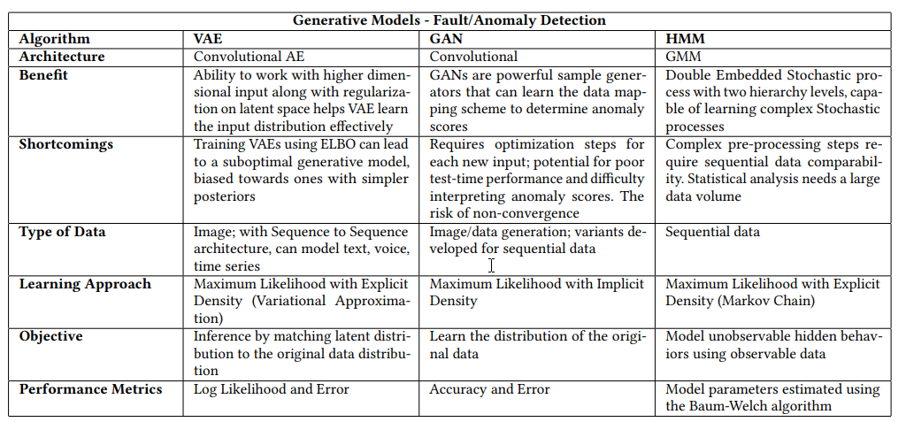
Generative Model Approaches
Comparison
Fig:10 Generative Model Approaches - Comparison
First International Medical Device Safety Risk Management Conference | Generative Models for Fault Detection | April 2024

Slide 21
Deep Generative Model Approaches
Model Training
HMM:
Utilized a binary state model with 'normal' and 'anomalous' states for simplicity and real-time efficiency.
We experimented with different thresholds by testing various percentiles of log-likelihood values. The best threshold was found at the 21st percentile of log-likelihood, which yielded the highest F1 score, effectively balancing the detection of anomalies (recall) while minimizing false alarms (precision). This approach ensured a robust and efficient anomaly detection system, tuned to perform well in real-time scenarios.
VAE:
Architecture includes an encoder and decoder with ReLU and sigmoid activations and Dropout to prevent overfitting.
Optimized using a composite loss function (reconstruction loss + KL divergence) for enhanced data reconstruction.
GAN:
Consists of a generator and discriminator with layered architectures using Relue and Tanh activations in the generator and LeakyReLU activations in the discriminator, along with sigmoid in the final layer for binary classification. BatchNormolizer in generator and Dropout is used for regularization in the discriminator.
Both are optimized using the Adam optimizer, and the loss function used is binary_crossentropy.
First International Medical Device Safety Risk Management Conference | Generative Models for Fault Detection | April 2024
Notes:
LeakyReLU is used in neural networks because it addresses the problem of "dying neurons" that can occur with the standard ReLU activation function. In ReLU, if a neuron gets a negative input, it's output is zero, which can lead to situations where neurons stop participating in the data processing as they stop learning. LeakyReLU allows a small, non-zero gradient when the unit is not active (i.e., when the input is negative), which keeps the neurons alive and continues the learning process. This small gradient ensures that all the neurons in the network remain active and contribute to the learning process, leading to more effective training of the model

Slide 22
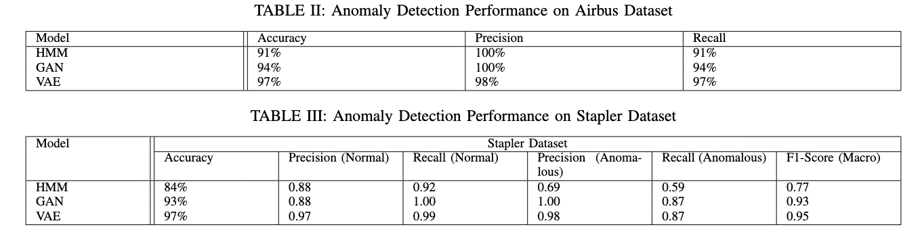
Deep Generative Model Approaches
Model Performance
Benchmarking Metrics: Accuracy measures the overall correctness, precision assesses the ability to avoid false positives, and recall indicates effectiveness in identifying true positives.
Performance Overview: Comparative results are presented in Fig 11, showcasing each model's strengths and weaknesses in fault detection, based on the Airbus and Stapler datasets
Generative Methods' Superiority: The research highlighted the exceptional performance of generative models, especially GAN and VAE, with a window size of 1024 ms, showcasing their potential in real-world anomaly detection scenarios
Model-Specific Outcomes: The VAE model demonstrated a notable accuracy of 97%, while GAN achieved 93% accuracy. The HMM model also performed well, with an accuracy rate of 84%, underlining the effectiveness of these models compared to previous studies
First International Medical Device Safety Risk Management Conference | Generative Models for Fault Detection | April 2024

Slide 23
Deep Generative Model Approaches
Conclusion and Future Work
Study Conclusion:
Real world comparison of GANs, VAEs, and HMMs for fault detection in Medical Device
The superior performance of deep generative models (like GANs and VAEs) compared to HMMs on the stapler dataset suggests the need for complex models to accurately capture the stapler's intricate dynamics.
High accuracy in learning and detecting anomalies in time-series data
Future Research Directions:
Aim for broader practical implementation in real-world medical settings
Define the cause of anomalies by using causal models to identify which part of the device is responsible for the fault.
Challenges with Generative Models:
Computationally intensive, requiring significant hardware resources
Large data requirements may pose challenges due to medical data privacy
Risk of overfitting, crucial to address for medical application accuracy
First International Medical Device Safety Risk Management Conference | Generative Models for Fault Detection | April 2024

Slide 24
Deep Generative Model Approaches
Data Availability & Acknowledgement
We would like to extend our heartfelt gratitude to Medtronic’s Surgical Operating Unit for granting us access to the data essential for this experiment. Their support has been invaluable in the advancement of this research.
It is important to note that the data obtained from the medical device were sourced from a lab experiment and are not clinical data. Furthermore, all real values in the experiment have been anonymized for data protection and privacy
Resources & Data
Airbus Helicopter Accelerometer Dataset: This dataset is publicly available and can be accessed from ETH Zürich’s Research Collection - https://www.research-collection.ethz.ch/handle/20.500.11850/415151
Surgical Stapler Dataset: Due to security and privacy considerations, the Surgical Stapler dataset is not publically available
The code developed for this study is available in a GitHub repository and can be accessed via the following link https://github.com/UNHSAILLab/Fault-Detection-on-Surgical-Stapler-
First International Medical Device Safety Risk Management Conference | Generative Models for Fault Detection | April 2024

Slide 25
THANK YOU
For any questions, please reach out to Bahareh.arghavani@gmail.com
Link to Project Site - https://sail-lab.org/portfolio/fault-detection-and-prognosis-in-medical-devices/
Portfolio: https://barghavanii.github.io/
Notes:
add contact information - email/website/sail lab

Slide 26
Fault Detection and Prediction
References
[WZ89] K Wawryn and W Zinka. \A prototype expert system for fault diagnosis in electronic devices". In: 1989
European Conference on Circuit Theory and Design. IET. 1989, pp. 677{680
[Fra96] Paul Martin Frank. \Analytical and qualitative model-based fault diagnosis{a survey and some new
results". In: European Journal of control 2.1 (1996), pp. 6{28.
[HR10] Vaishali Hegde and Dev Raheja. \Design for reliability in medical devices". In: 2010 Proceedings-Annual Reliability and Maintainability Symposium (RAMS). IEEE. 2010, pp. 1{6.
[Abu17] Bassem Abu-Nasser. \Medical expert systems survey". In: International Journal of Engineering and Information Systems (IJEAIS) 1.7 (2017), pp. 218{224.
[Kor+19] Mojtaba Kordestani et al. \Failure prognosis and applications|A survey of recent literature". In: IEEE
transactions on reliability (2019).
[Son+20] Wenyan Song et al. \Human factors risk assessment: An integrated method for improving safety in
clinical use of medical devices". In: Applied Soft Computing 86 (2020), p. 105918.
[GG] Aditya Gulati and Jeetsagar Ghorai. \Prognostic Health Management for Turbofan Engines"
[CB22] Benjamin Clapp, et al. "Stapler malfunctions in bariatric surgery: an analysis of the MAUDE database." In: JSLS: Journal of the Society of Laparoscopic & Robotic Surgeons 26.1 (2022)
[JSR13] Raoul Jetley, Sithu Sudarsan, and Srini Ramaswamy. "Medical Software–Issues and Best Practices." In: Proceedings of the 9th International Conference on Distributed Computing and Internet Technology (ICDCIT 2013), Bhubaneswar, India, February 5-8, 2013. Springer Berlin Heidelberg, 2013.
[KM19] Mojtaba Kordestani, et al. "Failure prognosis and applications—A survey of recent literature." IEEE Transactions on Reliability, vol. 70, no. 2, 2019, pp. 728-748.
[AH13] Homa Alemzadeh, et al. "Analysis of safety-critical computer failures in medical devices." IEEE Security & Privacy, vol. 11, no. 4, 2013, pp. 14-26
First International Medical Device Safety Risk Management Conference | Generative Models for Fault Detection | April 2024

Slide 27
Fault Detection and Prediction
References
[DSJN19] Matheus Maia de Souza, João Cesar Netto, and Renata Galante. "FFT-2PCA: A New Feature Extraction Method for Data-Based Fault Detection." In: Database and Expert Systems Applications: 30th International Conference, DEXA 2019, Linz, Austria, August 26–29, 2019, Proceedings, Part I, vol. 30. Springer International Publishing, 2019.
[YuL03] Lei Yu, and Huan Liu. "Feature selection for high-dimensional data: A fast correlation-based filter solution." In: Proceedings of the 20th International Conference on Machine Learning (ICML-03), 2003
[TsimpirisA12] Alkiviadis Tsimpiris, and Dimitris Kugiumtzis. "Feature selection for classification of oscillating time series." Expert Systems, vol. 29, no. 5, 2012, pp. 456-477.
[MartinT91] T. Patrick Martin, et al. "A knowledge-based system for fault diagnosis in real-time engineering applications." In: Database and Expert Systems Applications: Proceedings of the International Conference in Berlin, Federal Republic of Germany, 1991. Springer Vienna, 1991.
[HaTMP19] Thi Minh Phuong Ha, et al. "Experimental study on software fault prediction using machine learning model." In: 2019 11th International Conference on Knowledge and Systems Engineering (KSE). IEEE, 2019.
[BooyseWH20] Wihan Booyse, et al. "Deep digital twins for detection, diagnostics and prognostics." In: Mechanical Systems and Signal Processing 140 (2020): 106612
First International Medical Device Safety Risk Management Conference | Generative Models for Fault Detection | April 2024

